Slide 1


Phase Noise Testing of Microwave Oscillators
David Chan
Mentor: Mike Parker

Slide 2
Background
Rincon Research recently started working in millimeter wavelength region with radar and communication evaluation boards.
Lab was set up to test performance of boards and capabilities of various microwave chips.
Plans are being made for Rincon’s own development of microwave products with integrated chips needing phase noise testing.

Slide 3
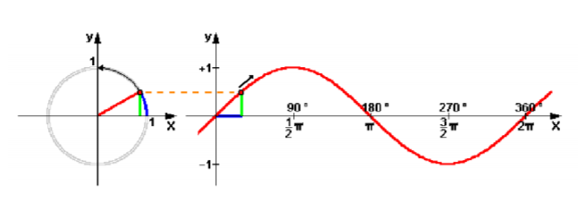
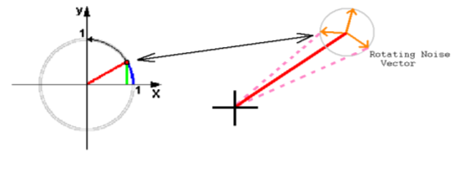
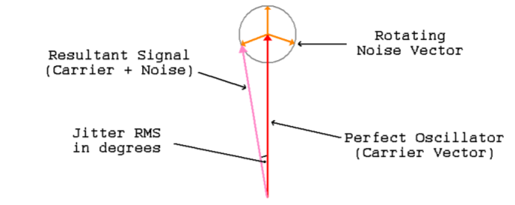
What is Phase Noise?
Stability of an oscillator in the frequency domain
Can be seen as jittering in the time domain representation of the carrier signal
Vector of the signal plus the vector of noise = offset vector
Resultant vector becomes spectral side bands in our spectrum
Phase noise is important for a reliable communications link and higher data throughput

Slide 4
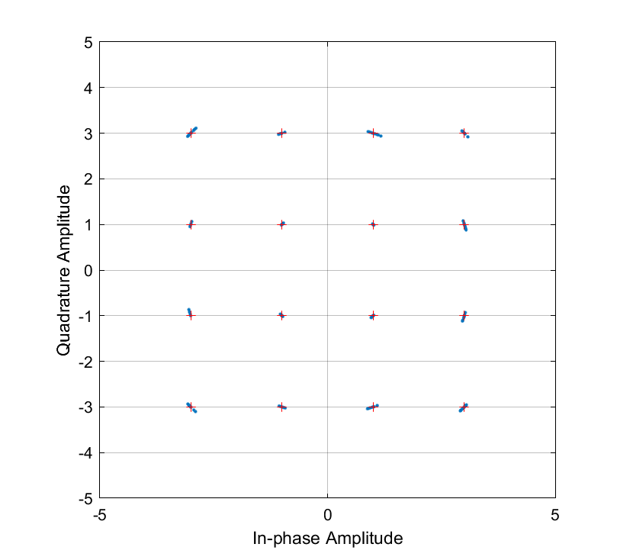
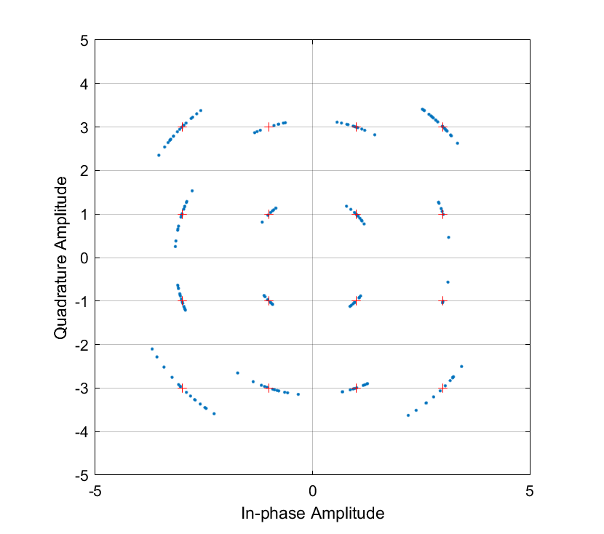
Simulated Effects of Phase Noise on 16QAM
Quadrature Amplitude
Quadrature Amplitude
In Phase Amplitude
In Phase Amplitude

Slide 5
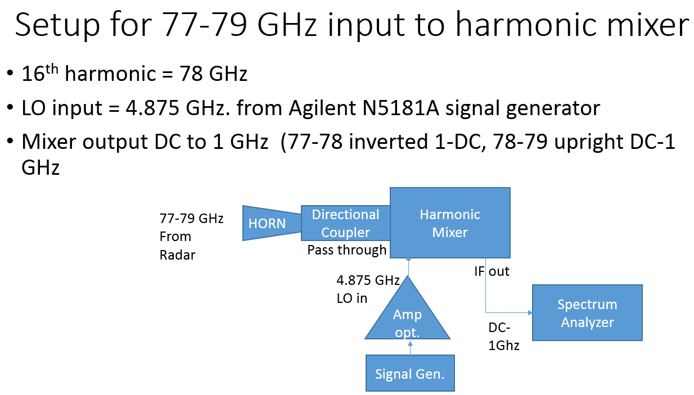
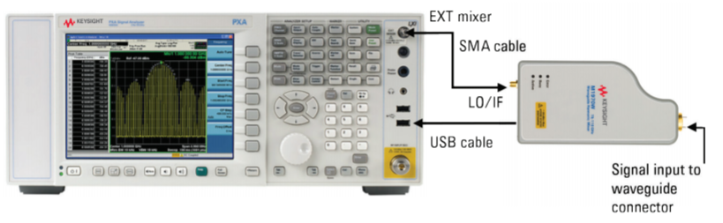
Testbench Setup and Measurements
Two separate harmonic mixers were used to be able to achieve high frequency measurements using our spectrum analyzer

Slide 6
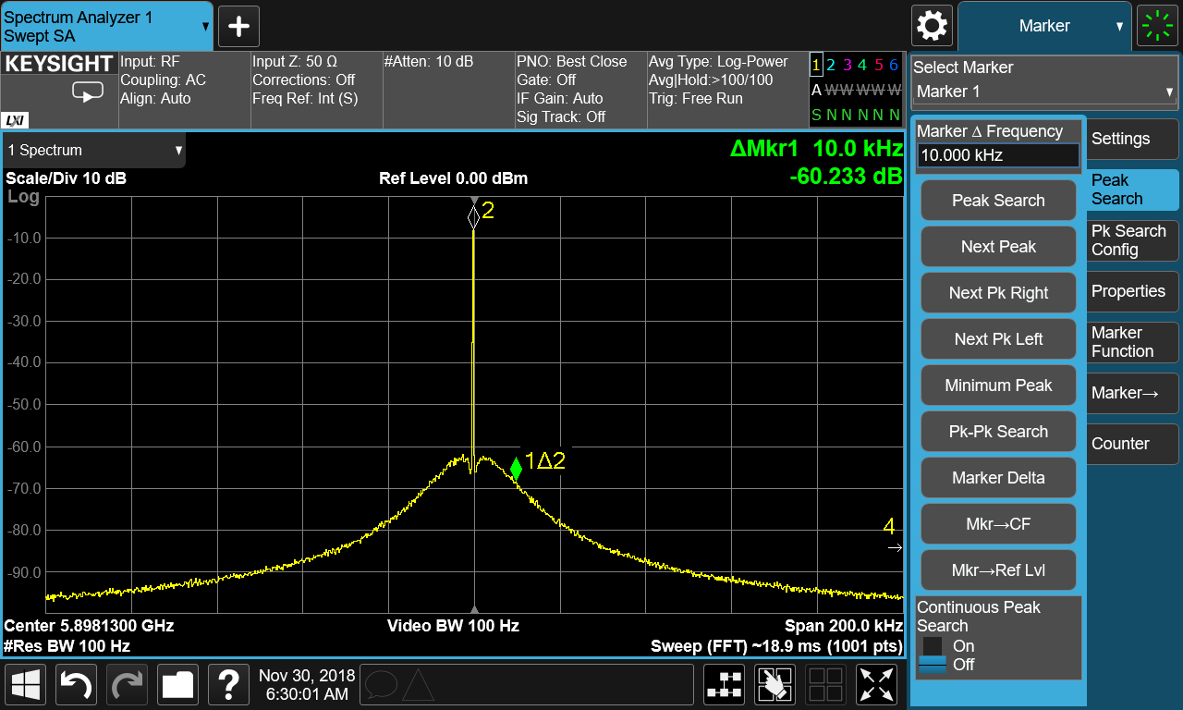
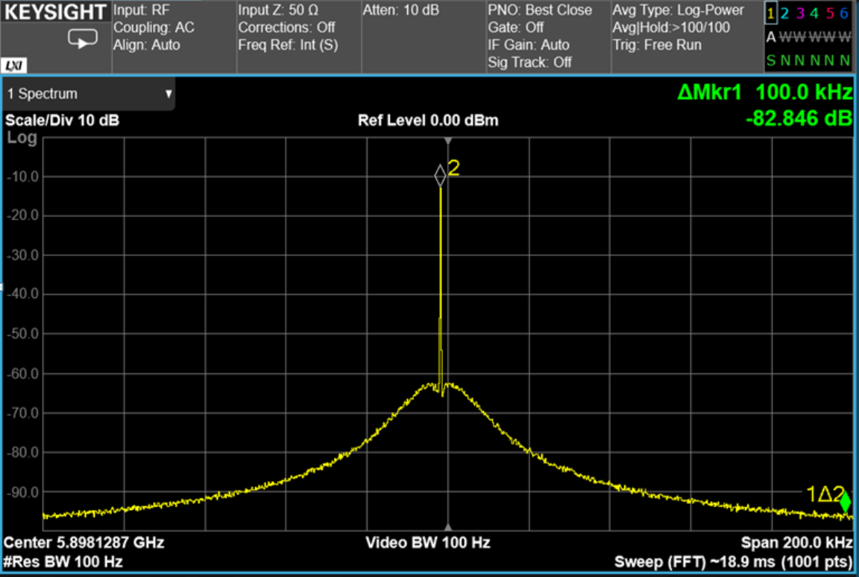
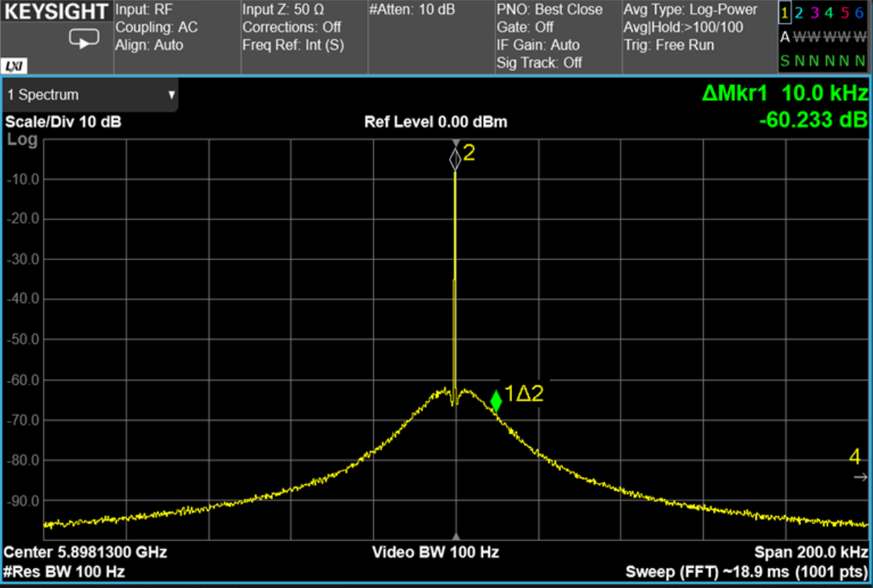
Spectral Pictures of Analog Devices ADF5356
10 kHz offset (left) and 100 kHz offset (right)
Main peak is the desired frequency while the sloping sidelobes are phase noise spillover.

Slide 7
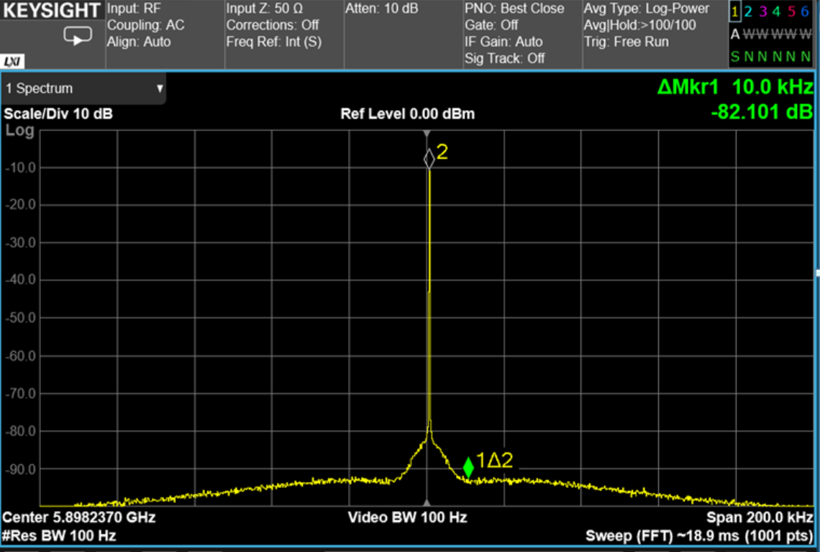
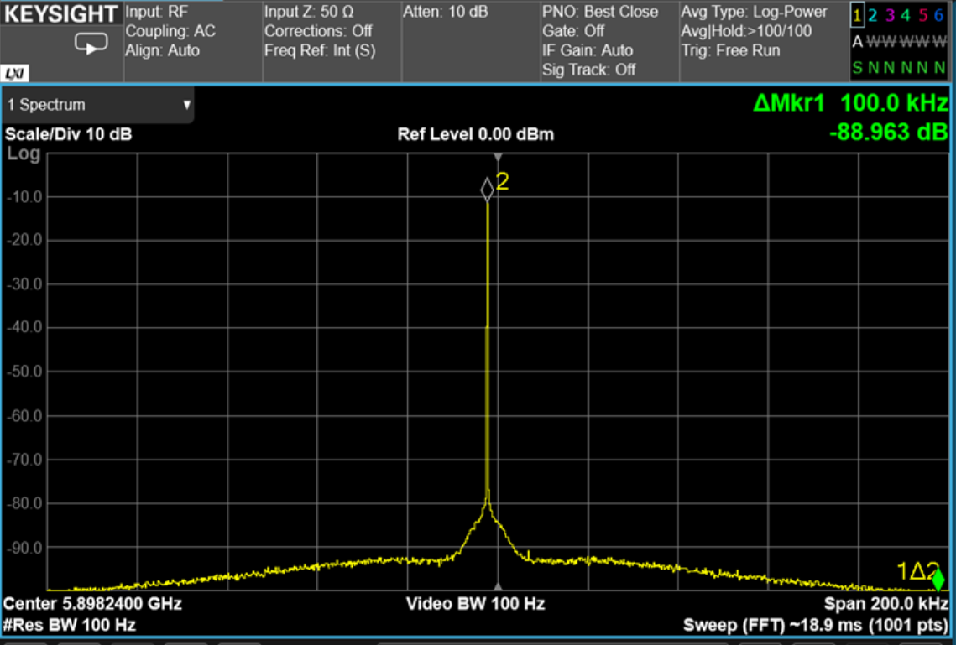
Agilent Signal Generator
10 kHz offset (left) and 100 kHz offset (right)
Much cleaner signal with a lower noise floor near the carrier frequency

Slide 8
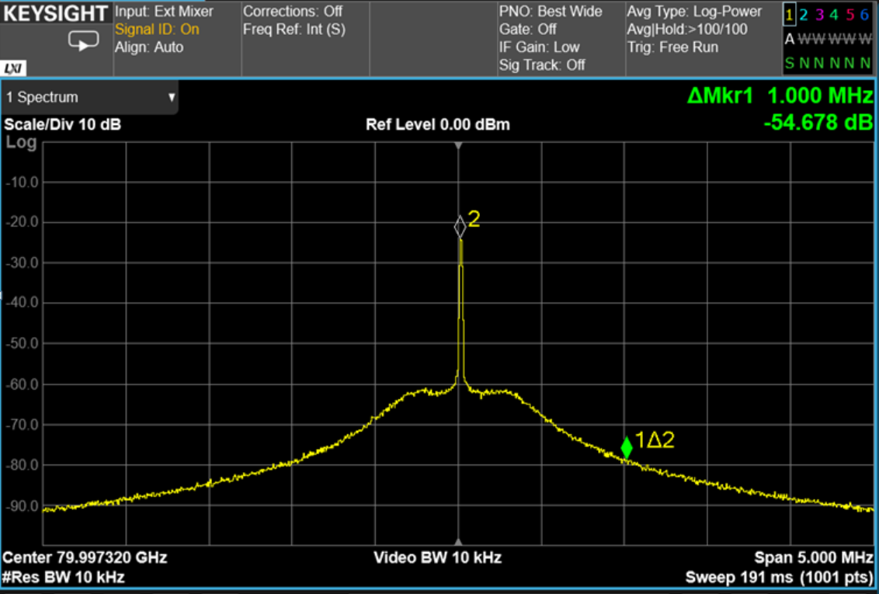
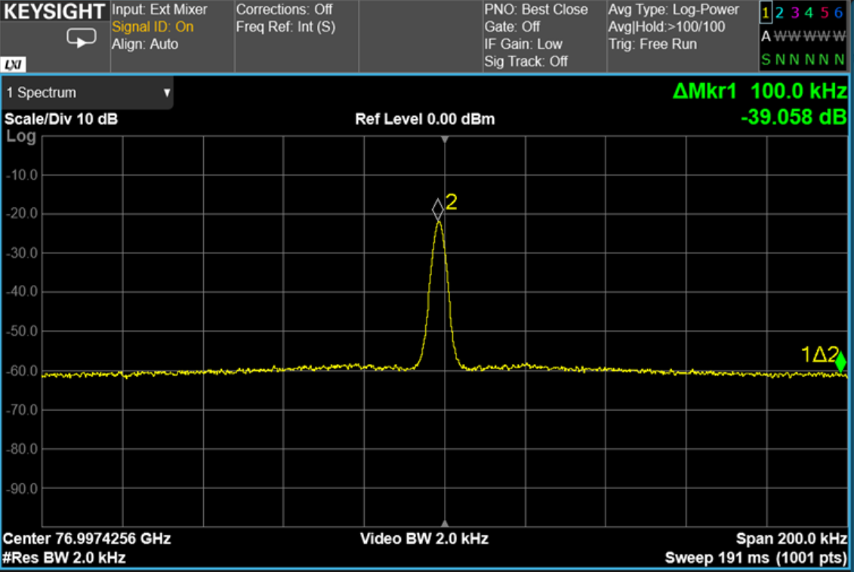
Automobile Radar AWR1642
1 MHz offset (left) and 100 kHz offset (right)
Needed more bandwidth and wider span to capture the whole characteristic phase noise shape

Slide 9
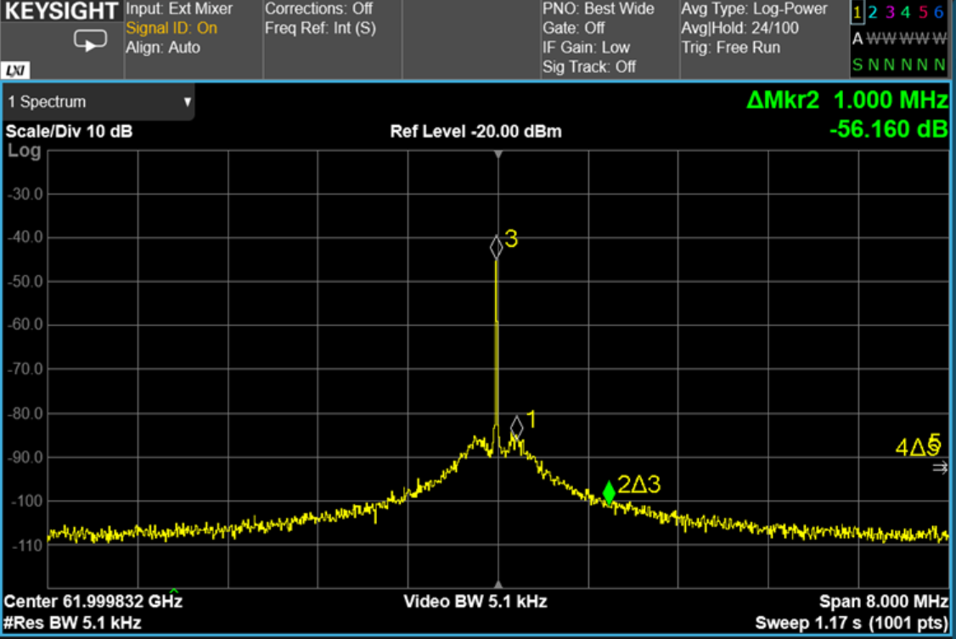
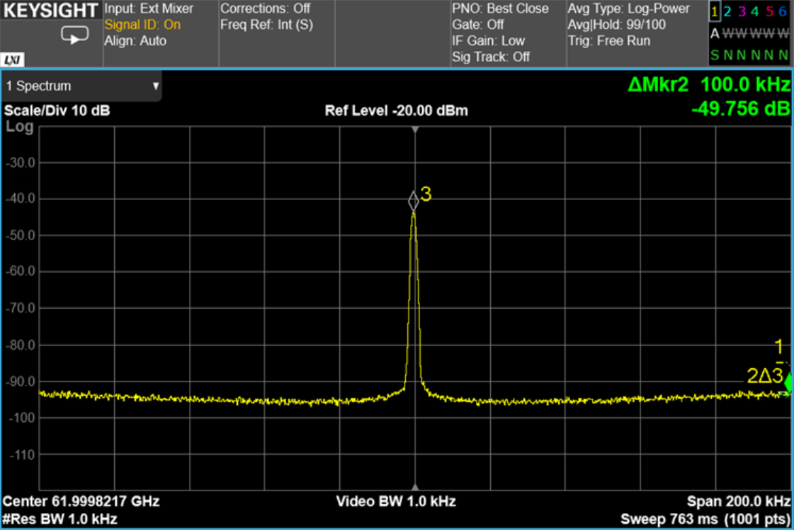
Analog Devices HMC6300 Transmitter
1 MHz offset (left) and 100 kHz offset (right)
Similar problem to the radar board but with better noise characteristics

Slide 10
Conclusion
Oscillators performed at or near spec. following our measurements
At mmWave frequencies, the oscillator at 60 GHz is only 2.6 dB worse than the laboratory grade signal generator while at 80 GHz it is 9.4 dB worse.
Next steps:
  Possibly use an Analog Devices chip in an Rincon RF board design
  Use in low noise mmWave receivers for upcoming projects
  Test receivers/antennas in microwave region

Slide 11
Thank you
NASA Space Grant Consortium and Rincon Research Corp.
Special thanks to my helpful mentor Mike Parker

Slide 12
Direct Spectrum Method
One of the various ways to measure phase noise was through a high quality Spectrum Analyzer and harmonic mixer.
Since some synthesizers had different frequencies an assumption was made to scale to the same carrier frequency.
  A factor of some value N to multiply up in frequency would be the squared ratio in power.
  Total phase noise power is small compared to the carrier power, the ratio of sideband power to carrier power is a measurement of phase noise.
Bandwidths were measured at 100Hz which were normalized to 1 Hz for typical phase noise measurements.

